Slide 1
Mobility in Mobile Datasets

Slide 2
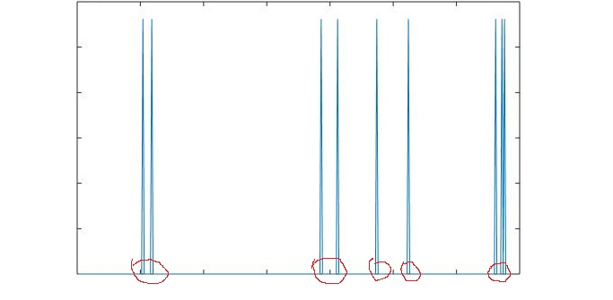
Mobility is based on number of hops in a time interval
Distance between towers: 1000m
Walking speed: 5km/h
Bus or car speed > 25km/h
Using 24km\h as a threshold, we have average coverage passing time for each tower: 150s
We then cut the stream of app history into sessions.

Slide 3
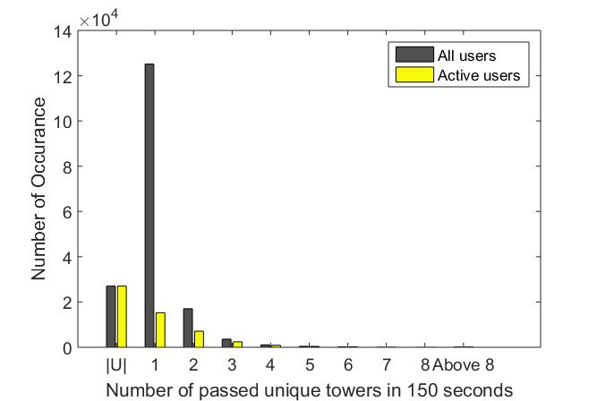

Slide 4
Classify sessions of users by number of passed towers
We count sessions that the user passes more than 2 towers as a active session
We count sessions that the user passes 1 towers as a static session
Note: We only study the high active sessions

Slide 5
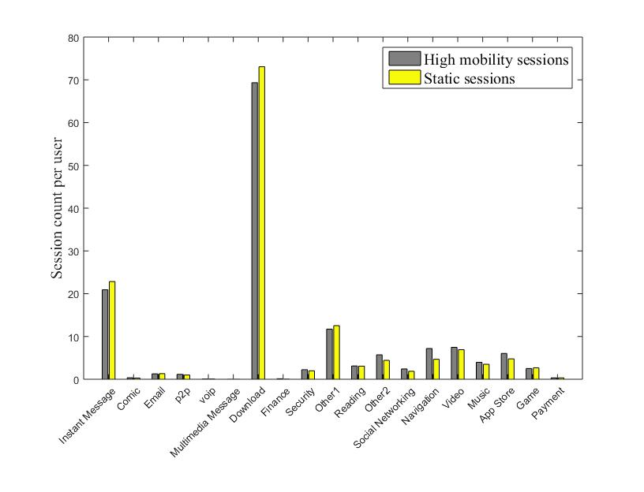

Slide 6
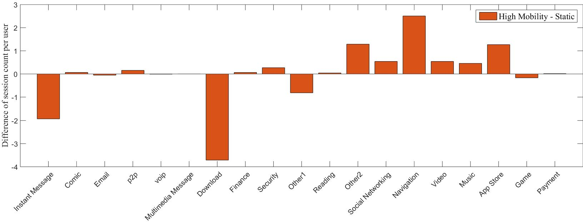
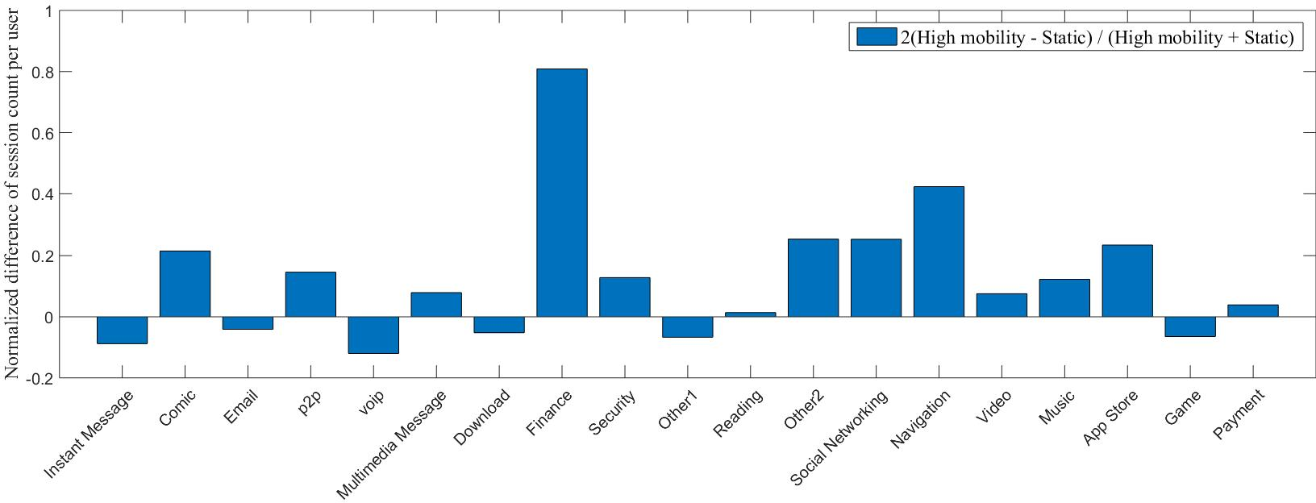

Slide 7
Some thoughts
Access difference for various categories:
Static sessions: IM, VOIP, Download, Game
Active sessions: Comic, P2P, Finance, Security, Social Net, Navigation, Music, Video, APP
Same: Email, MMS, Payment
Reasons for difference in application usage:
Various needs: Navigation
WiFi availability: Comic, Social Net …

